Slide 1

ML Sys for Fairness Proposal
Jade Preston & Navya Annapareddy
PhD Degree Program
School of Data Science
University of Virginia

Slide 2

Agenda
Jade’s Introduction
Navya’s Introduction
Proposal Topic

Slide 3
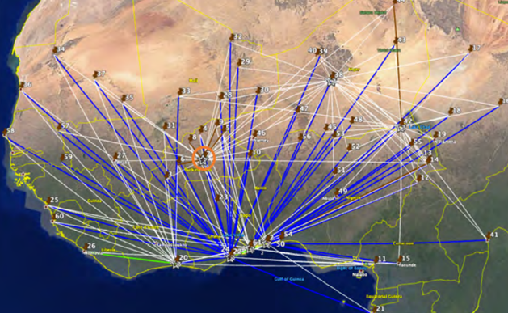
Research Experience
Education: B.S. Mathematics,
Mary Baldwin University;
M.S. Operations Research,
Air Institute of Technology
Previous Research: JDAL paper- Developing a resilient and efficient supply network in Africa
Topic Area Knowledge: (1) Weapons of Math Destruction; (2) Improving Fairness in Machine Learning Systems

Slide 4
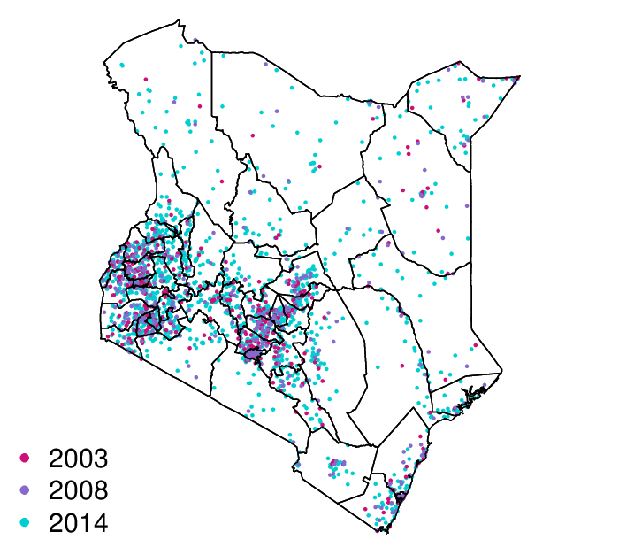
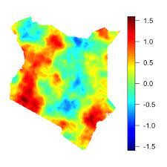
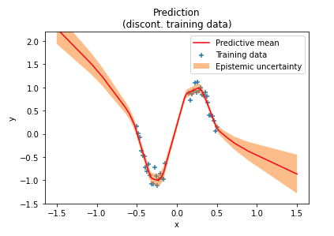
Research Experience
Education: B.S. Systems Engineering, University of Virginia, M.S. Data Science, University of Virginia
Current Research: Pose Estimation, Federated Learning
Previous Research: OCR on Medical Records, Global Household Disease Modeling
Topic Area Knowledge: (1) Pose Estimation (2) Medical Imaging

Slide 5
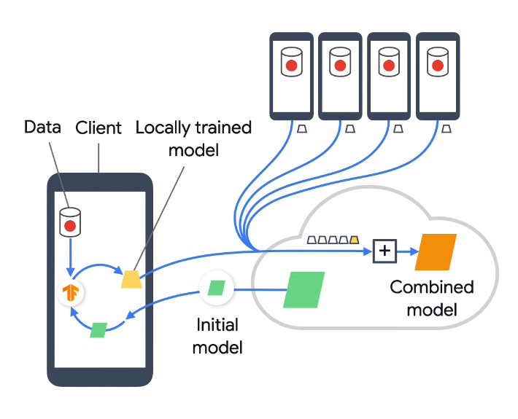
Federated Learning
Distributed learning model ideal for sensitive data like those that are HIPPA protected
Central server and nodes
Local updates on nodes, ensembled into global model
Enables decentralized model framework
Communication
Asynchronous
Ensemble methods
Systems level decisions
Containerization
Peer to peer networking

Slide 6
Proposal – Fairness in ML
Fairness Observation Team
Define fairness in the context of a given project domain
Evaluate fairness of the system design and at each level within the system design
Aim to mitigate biased decisions as well as balance tradeoffs between model performance and changes to related fairness

Slide 7
Proposal – Fairness in ML
Methods
Examine bias in
Human decision loops
Datasets
Distribution of included/excluded groups
Performance
Distribution across groups
Access/Privacy
Criminal Justice
Healthcare

Slide 8
We are excited to work with you!
yry2jy@virginia.edu
na3au@virginia.edu

